Slide 1
LI: To define and calculate the...
Perimeter and area
What do you already know?

Slide 2
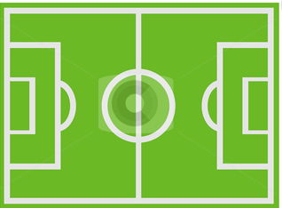
Find the perimeter
4 m
8 m

Slide 3
Find the perimeter
5m
10m

Slide 4

Find the perimeter
5 cm
12 cm

Slide 5

Find the perimeter
10 cm
15 cm

Slide 6

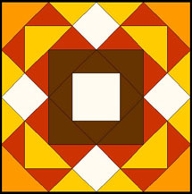
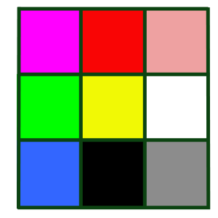
Find the perimeters
A)
1 m
3 m
C)
B)
9cm
5cm

Slide 7
Find the perimeters
A square with sides 1cm
A rectangle with sides 2cm and 4cm

Slide 8
Find the area
4 m
8 m

Slide 9
Find the area
5m
10m

Slide 10
Find the area
5 cm
12 cm

Slide 11
Find the area
10 cm
15 cm

Slide 12
Find the areas
A)
1 m
3 m
C)
B)
9cm
5cm

Slide 13
Find the areas
A square with sides 1cm
A rectangle with sides 2cm and 4cm

